Slide 1
Exception Handling in Java
UNIT –VI
PRINCIPLES OF PROGRAMMING LANGUAGES
PPL - SE SEM II (2016-17)

Slide 2
Syllabus
Fundamental, Exception types, uncaught exceptions, try, catch, throw, throws, finally, multiple catch clauses, nested try statements, built-in exceptions, custom exceptions (creating your own exception sub classes). Managing I/O: Streams, Byte Streams and Character Streams, Predefined Streams, Reading console Input, Writing Console Output, Print Writer class,
Applet: Applet Fundamental, Applet Architecture, Applet Skeleton, Requesting Repainting, status window, HTML Applet tag, passing parameters to Applets, Difference between Applet and Application Program.

Slide 3
Exception Handing-Introduction
Exception is an event,
Occurs during the execution of the program,
that an interrupt the normal flow of the program‘s instruction.
Exceptions are generated
when a recognized condition, usually an error condition, arises during the execution of a method.
System for running exceptions - each method to throw specific exceptions.

Slide 4
Exception Handling
What is an exception?
It is an abnormal conditions that arises in a code sequence at a run time.
Exception is a run time error which arises during the execution of java program. This term is known as “exception event” in java.
Exception arise for many reasons: i.e

Slide 5
Exception Handling…Contd…
Exception can be generated by - Java runtime system or they can be manually generated by code.
such as
Run out of memory
Resource allocation Error
Inability to find a file
Problems in Network connectivity.
Exception Handling is a mechanism to handle runtime errors such as ClassNotFound, IO, SQL, Remote etc.

Slide 6
Reason of exception handling
Invalid data entry
A file that needs to be opened cannot be found.
A network connection has been lost in the middle of communication.
JVM has run out of memory.
“if the exception object not handled properly, the interpreter will display the error and will terminate the program.”
To maintain the normal flow of the application.

Slide 7
Types of exception
Checked exception:
Checked exceptions are subject to the Catch or Specify Requirement.
Checked exceptions are checked at compile-time.
All exceptions are checked exceptions, except for those indicated by Error, RuntimeException, and their subclasses.
Error
Checked exceptions are subject to the Catch or Specify Requirement.
All exceptions are checked exceptions, except for those indicated by Error, RuntimeException, and their subclasses.
Runtime exception
These are exceptional conditions that are internal to the application, and that the application usually cannot anticipate or recover from.
These usually indicate programming bugs, such as logic errors or improper use of an API
checked at runtime.

Slide 8
Types of exception
An error means fault and there are two types of error as follows:
Compile time errors like
Missing braces, Missing semicolon, Missing double quote in string, = instead of == operator And so on.
Run time errors like
Divide by zero
Conversion of invalid string to number
access the element that is out of bound of an array
Passing the parameters……

Slide 9
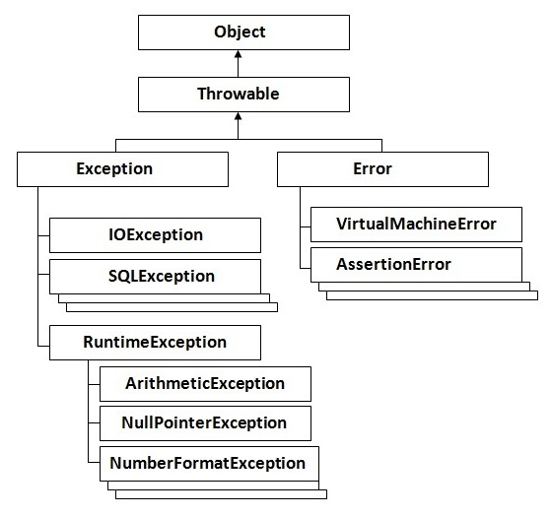
Hierarchy of Java Exception classes

Slide 10
Exception handling fundamentals
Java exception handled by 5 keywords:
Try
Catch
Finally
Throw
Throws.

Slide 11
try…catch
Program statement that is placed inside a try block
Want to monitor for exception.
Could generate the exception.
If the exception occurs in the try block, it is thrown.
Catch block catch this exception and handle it in some logical manner.
Syntax
try
{
// Statement that can generate exception
}

Slide 12
try…catch
there can be more than one catch block, each one marked for a correct exception class
the catch block(s) must handle all checked exceptions.
it is possible to have a try block without any catch blocks if you have a finally block.
catch (ExceptionClassName exceptionObjectName)
{
code using methods from exceptionObjectName
}

Slide 13
Using Multiple catch Blocks
A statement might throw more than one kind of exception
List a sequence of catch blocks, one for each possible exception.
There is an object hierarchy for exceptions

Slide 14
Finally block
To guarantee that a line of code runs, whether an exception occurs or not,
Use a finally block after the try and catch blocks.
finally block will almost always execute, even if an unhandled exception occurs.
It's possible to have a try block followed by a finally block, with no catch block
This is used to prevent an unchecked exception from exiting the method before cleanup code can be executed.

Slide 15
Finally block
try {
risky code/ unsafe code block
}
catch (ExceptionClassName exceptionObjectName) {
code to resolve problem
}
finally{
code that will always execute
}

Slide 16
Key points
If an exception occurs within the try block, that exception is handled by an exception handler associated with it.
To associate an exception handler with a try block, you must put a catch block after it.
Providing one or more catch blocks directly after the try block.
No code can be between the end of the try block and the beginning of the first catch block.

Slide 17
Key points
Out of ‘n’ catch block only one block get executed.
finally block is executed even if an unexpected exception occurs.

Slide 18
syntax
try {
//block of code monitor for error
}
catch (ExceptionType name1 e1) {
//Exception handler for exception type 1
}
catch (ExceptionType name2 e2) {
//Exception handler for exception type 2
}
finally {
//block of code to be executed before end of the code.
}

Slide 19
Example
import java.io.*;
public class ExcepTest{
public static void main(String args[]){
try{
int a[] = new int[2];
System.out.println("Access element three :" + a[3]);
}
catch(ArrayIndexOutOfBoundsException e){
System.out.println("Exception thrown :" + e);
}
System.out.println("Out of the block");
}
}
Output
Exception thrown :java.lang.ArrayIndexOutOfBoundsException: 3
Out of the block

Slide 20
Multiple catch
public class ExcepTest{
public static void main(String args[]){
int a[] = {5,10}; int b=5;
try{
int x=a[2]/b-a[1];
}
catch(ArithmaticException e){
System.out.println(“Divide by zero");
}
catch(ArrayIndexOutOfBoundsException e){
System.out.println(“Array Index Error ");
}
catch(ArrayStoreExeption e){
System.out.println(“Wrong Data type");
}
} }
OUTPUT :
Array Index Error

Slide 21
Finally
public class ExcepTest{
public static void main(String args[]){
int a[] = new int[2];
try{
System.out.println("Access element three :" + a[3]); }
catch(ArrayIndexOutOfBoundsException e) {
System.out.println("Exception thrown :" + e); }
finally{
a[0] = 6;
System.out.println("First element value: " +a[0]);
System.out.println("The finally statement is executed"); }
} }
OUTPUT:
Exception thrown :java.lang.ArrayIndexOutOfBoundsException: 3
First element value: 6 The finally statement is executed

Slide 22
Predefined Exception in java
Exception | Description
ArithmeticException | Arithmetic error, such as divide-by-zero.
ArrayIndexOutOfBoundsException | Array index is out-of-bounds.
ArrayStoreException | Assignment to an array element of an incompatible type.
ClassCastException | Invalid cast.
IllegalArgumentException | Illegal argument used to invoke a method.
IllegalMonitorStateException | Illegal monitor operation, such as waiting on an unlocked thread.
IllegalStateException | Environment or application is in incorrect state.
IndexOutOfBoundsException | Some type of index is out-of-bounds.
NegativeArraySizeException | Array created with a negative size.
NullPointerException | Invalid use of a null reference.
NumberFormatException | Invalid conversion of a string to a numeric format.
SecurityException | Attempt to violate security.
StringIndexOutOfBounds | Attempt to index outside the bounds of a string.
UnsupportedOperationException | An unsupported operation was encountered.
IllegalThreadStateException | Requested operation not compatible with current thread state.

Slide 23
Throw
System generated exception are automatically thrown by java run time system.
throws keyword gives a method flexibility of throwing an Exception rather than handling it.
with throws keyword in method signature a method suggesting its caller to prepare for Exception declared in throws clause, specially in case of checked Exception and provide sufficient handling of them.

Slide 24
throw
All methods use the throw statement to throw an exception.
Syntax:
throw new Exception_type(arg);
OR
catch(Exception_ type object)
{
throw object;
}

Slide 25
Example
import java.util.Scanner;
public class Exercise {
public static void main(String[] args) {
int studentAge = 0;
Scanner scnr = new Scanner(System.in);
try {
System.out.print("Student Age: ");
studentAge = scnr.nextInt();
if( studentAge < 0 )
throw new Exception("Positive Number Required");
System.out.println("Student Age: " + studentAge);
}
catch(Exception exc)
{
System.out.println("Error: " + exc.getMessage());
} } }
Notes:
This program starts with the try block that asks the user to enter a positive number. If the user enters an invalid value, the program examines the throw keyword. This throw appears to display a string. The compiler registers this string and since there was an exception, the program exits the try block (it gets out of the try block even if the rest of the try block is fine) and looks for the first catch block it can find. If it finds a catch that does not take an argument, it would still use the catch. Otherwise, you can use the catch block to display the error string that was sent by the throw keyword.

Slide 26
throws
If a method does not handle a checked exception, the method must declare it using the throws keyword.
The throws keyword appears at the end of a method's signature.
All the exception that a method can throw must be declared in the throws clause.

Slide 27
Syntax
data_type method_name (argument_list) throws exception_list
{
body of method
}
Example:
import java.io.*;
public class className{
public void deposit(double amount) throws RemoteException {
// Method implementation
throw new RemoteException();
}
//Remainder of class definition
}

Slide 28
throw VS throws
throw | Throws
Java throw keyword is used to explicitly throw an exception. | Java throws keyword is used to declare an exception.
Checked exception cannot be propagated using throw only. | Checked exception can be propagated with throws.
Throw is followed by an instance. | Throws is followed by class.
Throw is used within the method. | Throws is used with the method signature.
You cannot throw multiple exceptions. | You can declare multiple exceptions e.g. public void method()throws IOException,SQLException.

Slide 29
Nested Try Block
A situation may arise where a part of a block may cause one error and the entire block itself may cause another error.
In such cases, exception handlers have to be nested.

Slide 30
Example
class Excep6{
public static void main(String args[])
try{
try{
System.out.println("going to divide");
int b =39/0;
}catch(ArithmeticException e){System.out.println(e);}
try{
int a[]=new int[5];
a[5]=4;
}catch(ArrayIndexOutOfBoundsException e){System.out.println(e);}
System.out.println("other statement);
}catch(Exception e){System.out.println("handeled");}
System.out.println("normal flow..");
}
}

Slide 31
Java Custom /user-defined exception
creating your own exception sub classes.
Example
class InvalidAgeException extends Exception {
InvalidAgeException(String s){
super(s);
}
}

Slide 32
class TestCustomException1{
static void validate(int age)throws InvalidAgeException{
if(age<18)
throw new InvalidAgeException("not valid");
else
System.out.println("welcome to vote");
}
public static void main(String args[]){
try{
validate(13);
}catch(Exception m){System.out.println("Exception occured: "+m);}
System.out.println("rest of the code...");
}
}

Slide 33
Managing I/O
Java uses the concept of stream to make I/O operation fast.
java.io package contains all the classes required for input and output operations.

Slide 34
Stream
A stream is a sequence of data.
A stream is composed of bytes.
Following are 3 predefined streams:
All these streams are attached with console.
System.out: standard output stream
System.in: standard input stream
System.err: standard error stream

Slide 35
Stream
System.out.println("simple message");
System.err.println("error message");
The code to get input from console.
int i=System.in.read(); //returns ASCII code of 1st character
System.out.println((char)i);
//will print the character

Slide 36
I/O Streams
Byte Streams
Handle I/O of raw binary data.
can read or write the files containing ASCII characters that range from 0 to 255.
byte streams can copy the files containing English letters only but not of other languages.
Character Streams
Handle I/O of character data, automatically handling translation to and from the local character set.
operate on Unicode characters.
That is, character streams can read, write and copy the files containing other than English characters.

Slide 37
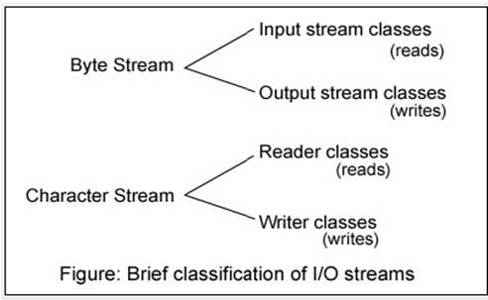
I/O Streams

Slide 38
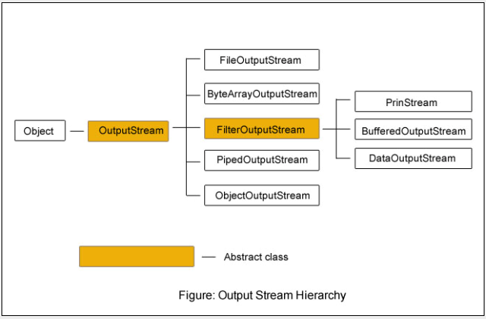
OutputStream Hierarchy

Slide 39
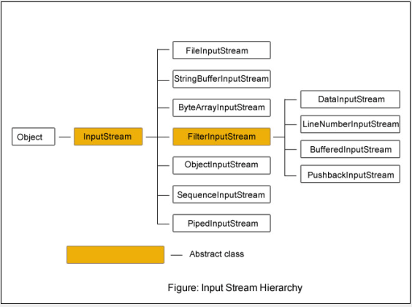
Input Stream Hierarchy

Slide 40
Reading console Input
System.in refers to standard input, which is the keyboard by default.
System.in is an object of type InputStream.
In Java, console input is accomplished by reading from System.in.
Syntax 1:
BufferedReader bReader=new BufferedReader(new InputStreamReader(System.in));

Slide 41
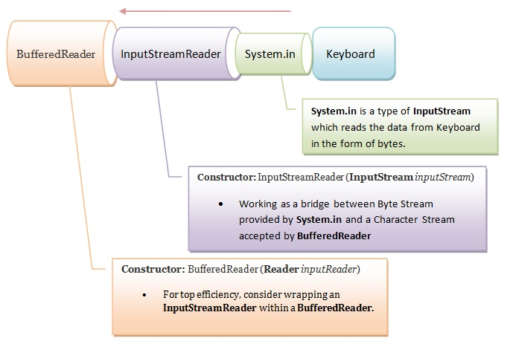
Reading console Input

Slide 42
Writing Console Output
System.out refers to standard output, which is the console by default.
System.out, and System.err are objects of type OutputStream.
print() and println() which are declared inside PrintStream class which is the type of the object referenced by System.out.
PrintStream is an outputStream derived from OutputStream
System.out is an object of type PrintStream.
Syntax
System.out.println("Hello SIT");
Notes:
Reading console input The preferred method of reading console input for Java is to use a character-oriented stream, which makes your program easier to internationalize and maintain. In java, input is accomplished by reading from System.in and for that you wrap System.in in a BufferedReader object, to create a character stream.
Writing console output Console output is most easily accomplished with print() and println() which are declared inside PrintStream class which is the type of the object referenced by System.out. PrintStream is an outputStream derived from OutputStream, it also implements the low-level method write(). Thus write() can be used to write to the console.

Slide 43
Example
mport java.io.*; public class Main { public static void main(String[] args) throws IOException { BufferedReader br=new BufferedReader(new InputStreamReader(System.in)); System.out.println("Enter the number"); int a=Integer.parseInt(br.readLine()); System.out.println("The number is "+a); } }
OUTPUT: Enter the number 10 The number is 10

Slide 44
Print Writer class
Java PrintWriter class is the implementation of Writer class.
It is used to print the formatted representation of objects to the text-output stream.

Slide 45
Methods of PrintWriter class
Method | Description
void println(boolean x) | It is used to print the boolean value.
void println(char[] x) | It is used to print an array of characters.
void println(int x) | It is used to print an integer.
PrintWriter append(char c) | It is used to append the specified character to the writer.
PrintWriter append(CharSequence ch) | It is used to append the specified character sequence to the writer.
PrintWriter append(CharSequence ch, int start, int end) | It is used to append a subsequence of specified character to the writer.
boolean checkError() | It is used to flushes the stream and check its error state.

Slide 46
Methods of PrintWriter class
protected void setError() | It is used to indicate that an error occurs.
protected void clearError() | It is used to clear the error state of a stream.
PrintWriter format(String format, Object... args) | It is used to write a formatted string to the writer using specified arguments and format string.
void print(Object obj) | It is used to print an object.
void flush() | It is used to flushes the stream.
void close() | It is used to close the stream.

Slide 47
Example
mport java.io.File;
import java.io.PrintWriter;
public class PrintWriterExample {
public static void main(String[] args) throws Exception {
//Data to write on Console using PrintWriter
PrintWriter writer = new PrintWriter(System.out);
writer.write("Javatpoint provides tutorials of all technology.");
writer.flush();
writer.close();
//Data to write in File using PrintWriter
PrintWriter writer1 =null;
writer1 = new PrintWriter(new File("D:\\testout.txt"));
writer1.write("Like Java, Spring, Hibernate, Android, PHP etc.");
writer1.flush();
writer1.close();
}
}

Slide 48
Applet
Special type of program that is embedded in the webpage to generate the dynamic content.
It runs inside the browser and works at client side.

Slide 49
Applet
Advantage of Applet
It works at client side so less response time.
Secured
It can be executed by browsers running under many plateforms, including Linux, Windows, Mac Os etc.
Drawback of Applet
Plugin is required at client browser to execute applet.

Slide 50
Applet
An applet is a Java class that extends the java.applet.Applet class.
A main() method is not invoked on an applet, and an applet class will not define main().
Applets are designed to be embedded within an HTML page.
When a user views an HTML page that contains an applet, the code for the applet is downloaded to the user's machine.
A JVM is required to view an applet. The JVM can be either a plug-in of the Web browser or a separate runtime environment.

Slide 51
Applet
The JVM on the user's machine creates an instance of the applet class and invokes various methods during the applet's lifetime.
Applets have strict security rules that are enforced by the Web browser. The security of an applet is often referred to as sandbox security, comparing the applet to a child playing in a sandbox with various rules that must be followed.
Other classes that the applet needs can be downloaded in a single Java Archive (JAR) file.

Slide 52
Applet life cycle
What is applet?
Applets are used to provide interactive features to web applications that cannot be provided by HTML alone
Java programs that can be embedded in HyperText Markup Language (HTML) documents
The browser that executes an applet is generically known as the applet container

Slide 53
Life Cycle of an Applet
The java.applet.Applet class 4 life cycle methods and java.awt.Component class provides 1 life cycle methods for an applet.
public void init(): is used to initialized the Applet. It is invoked only once.
public void start(): is invoked after the init() method or browser is maximized. It is used to start the Applet.
public void stop(): is used to stop the Applet. It is invoked when Applet is stop or browser is minimized.
public void destroy(): is used to destroy the Applet. It is invoked only once.

Slide 54
Cont…
java.awt.Component class
The Component class provides 1 life cycle method of applet.
public void paint(Graphics g): is used to paint the Applet. It provides Graphics class object that can be used for drawing oval, rectangle, arc etc.
Who is responsible to manage the life cycle of an applet?
Java Plug-in software.

Slide 55
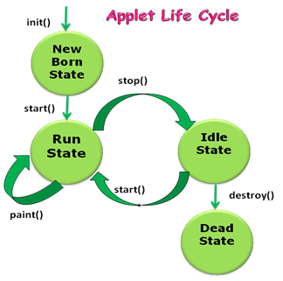
Life cycle
This is first method called when applet loads. This method can be used to set applet attributes like color, fonts etc.
This method starts a thread in which it runs the paint method.
This method is called every time when an applet has to re-display.
It is called when the user goes to the other page.
This is called when the browser exits. We can use this method for cleaning non java resources.

Slide 56
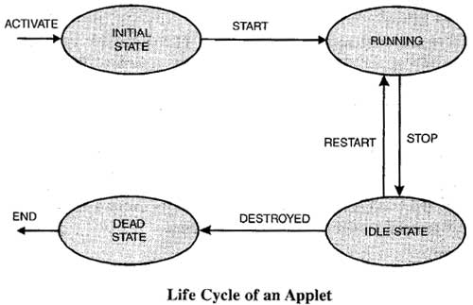

Slide 57
New Born State/ init()
The life cycle of an applet is begin on that time when the applet is first loaded into the browser and called the init() method.
The init() method is called only one time in the life cycle on an applet.
The init() method is basically called to read the PARAM tag in the html file.
The init () method retrieve the passed parameter through the PARAM tag of html file using get Parameter() method .
All the initialization such as initialization of variables and the objects like image, sound file are loaded in the init () method .
After the initialization of the init() method user can interact with the Applet

Slide 58
Running State/ start()
After initialization, this state will automatically occur by invoking the start method of applet class which again calls the run method and which calls the paint method.
The running state also occurs from idle state when the applet is reloaded.
This method may be called multiples time when the Applet needs to be started or restarted.
For Example if the user wants to return to the Applet, in this situation the start Method() of an Applet will be called by the web browser and the user will be back on the applet.
In the start method user can interact within the applet.
Syntax:
public void start() { Statements }

Slide 59
Idle State / stop()
The idle state will make the execution of the applet to be halted temporarily.
Applet moves to this state when the currently executed applet is minimized or when the user switches over to another page.
At this point the stop method is invoked.
From the idle state the applet can move to the running state.
The stop() method can be called multiple times in the life cycle of applet Or should be called at least one time.
For example the stop() method is called by the web browser on that time When the user leaves one applet to go another applet
Syntax:
public void stop() { Statements }

Slide 60
Dead State/ destroy()
When the applet programs terminate, the destroy function is invoked which makes an applet to be in dead state.
The destroy() method is called only one time in the life cycle of Applet like init() method.
Syntax:
public void destroy() { Statements }

Slide 61
Display State
The applet is said to be in display state when the paint method is called.
This method can be used when we want to display output in the screen.
This method can be called any number of times.
paint() method is must in all applets when we want to draw something on the applet window.
paint() method takes Graphics object as argument
Syntax:
public void paint(Graphics g) { Statements }

Slide 62
How to create a applet
Step1: Create a .java file
Create . Class file
Step2: Create a HTML file
Give .class file name in <applet> </applet> tag with filename, width and height.
Step3: Run your HTML page
Note: Keep HTML and JAVA file in same folder.

Slide 63
Creation of Java file
import java.applet.*;
import java.awt.*;
public class Main extends Applet{
public void paint(Graphics g){
g.drawString("Welcome in Java Applet.",40,20);
}
}

Slide 64
Create a HTML file
<HTML>
<BODY>
<div >
<APPLET CODE="Main.class" WIDTH="800" HEIGHT="500">
</APPLET>
</div>
</BODY>
</HTML>
Output: Welcome in Java Applet.

Slide 65
Use of Java.awt
Abstract Window Toolkit (AWT)
It’s a standard API for providing a graphical user interface (GUI) for a Java program (application programming interface (API))
Contains all of the classes for creating user interfaces and for painting graphics and images.
AWT is also the GUI toolkit for a number of Java ME profiles. For example, Connected Device Configuration profiles require Java runtimes on mobile telephones to support AWT.

Slide 66
Use of java.applet
Provides the classes necessary to create an applet and the classes an applet uses to communicate with its applet context.
Java applets can be part of a web page and executed by the Java Virtual Machine (JVM) in a process separate from the web browser, or run in Sun's AppletViewer, a stand-alone tool for testing applets.

Slide 67
Use of html tags
An HTML tag is a special piece of text that tells a web browser how to display things to the reader.
All HTML tags begin with the character "<" and end with the character ">".
An ending tag is just a repeat of the tag with a "/" in it. For instance, </B> is the closing for the <B> tag.

Slide 68
Use
<html></html> ---begins and ends web document, tells the browser that the document is in HTML
<title></title> ---located within header container
<body></body> ---creates the body of the document
<div></div> -- Specifies a logical division within a document. Use it to separate or identify chunks of content that are not otherwise distinguished naturally using other tags.
<applet></applet> --This tells the viewer or browser to load the applet whose compiled code is in MyApplet.class (in the same directory as the current HTML document), and to set the initial size of the applet to 100 pixels wide and 140 pixels high.

Slide 69
Create a applet to draw a shapes
<HTML>
<BODY>
<div align="center">
<APPLET CODE="CircleLine.class" WIDTH="800" HEIGHT="500"></APPLET>
</div>
</BODY>
</HTML>
import java.applet.*;
import java.awt.*;
public class CircleLine extends Applet{
int x=300,y=100,r=50;
public void paint(Graphics g){
g.drawLine(3,300,200,10);
g.drawString("Line",100,100);
g.drawOval(x-r,y-r,100,100);
g.drawString("Circle",275,100);
g.drawRect(400,50,200,100);
g.drawString("Rectangel",450,100);
}
}

Slide 70
The drawLine() method has been used in the program to draw the line in the applet. Here is the syntax for the drawLine() method : drawLine(int X_from_coordinate, int Y_from_coordinate, int X_to_coordinate, int Y_to_coordinate);
The drawSring() method draws the given string as the parameter. Here is the syntax of the drawString() method : drawString(String string, int X_coordinate, int Y_coordinate);
The drawOval() method draws the circle. Here is the syntax of the drawOval() method : g.drawOval(int X_coordinate, int Y_coordinate, int Wdth, int height);
Graphics.drawRect() : The drawRect() method draws the rectangle. Here is the syntax of the drawRect() method :
g.drawRect(int X_coordinate, int Y_coordinate, int Wdth, int height)

Slide 71
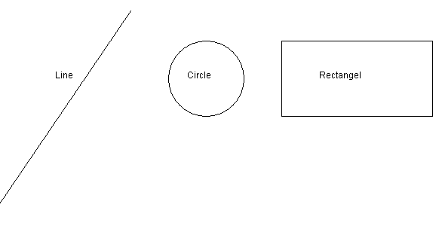
output

Slide 72
Example 2
import java.applet.*;
import java.awt.*;
public class SimpleApplet extends Applet{
String text = "I'm a simple applet";
public void init() {
text = "I'm a simple applet";
setBackground(Color.cyan);
}
public void start() {
System.out.println("starting...");
}
public void stop() {
System.out.println("stopping...");
}
public void destroy() {
System.out.println("preparing to unload...");
}
public void paint(){
System.out.println("Your can create -graphics in paint...");
}
}

Slide 73
<HTML>
<BODY>
<div align="center">
<APPLET CODE=“SimpleApplet.class" WIDTH="800" HEIGHT="500"></APPLET>
</div>
</BODY>
</HTML>

Slide 74
Requesting repainting
Applet must quickly return control to the AWT run-time system..
So to change a particular information itself, we can not make a loop in the paint method that repeatedly updates it.
whenever your applet needs to update the information displayed in its window, it simply calls repaint().
void repaint() //entire window
or
void repaint(int left, int top, int width, int height)
// specifies region to be repainted
Notes:
The paint () method is called automatically by the environment (usually a web browser) that contains the applet whenever the applet window needs to be redrawn.

Slide 75
repaint()
paint () method can be called explicitly whenever the applet window needs to be redrawn, using the repaint () method.
repaint() requests an erase and redraw (update) after a small time delay.
The repaint () method causes the AWT runtime system to execute the update () method of the Component class which clears the window with the background color of the applet and then calls the paint () method.

Slide 76
Status Window
Applet can also output a message to the status window of the browser or applet viewer on which it is running.
The status window gives the user feedback about what is occurring in the applet, suggest options, or possibly report some types of errors.
call showStatus( ), which is defined by Applet
void showStatus(String msg)
Here, msg is the string to be displayed.

Slide 77
Java applications
What is mean by application?
application runs stand-alone, with the support of a virtual machine.
Programs written in Java to carry out certain tasks on a stand alone local Computer. Executing stand alone java programs involves two steps
Compiling through javac compiler.
Executing the byte code using java interpreter.

Slide 78
Difference between applet and application
Applet | application
Applets must have GUI | Applications mayn,t have GUI.
Applet starts execution after init() method | Applications start execution after main() method.
Applets can be embedded in HTML pages and downloaded over the Internet | Applications have no special support in HTML for embedding or downloading.
Applets can only be executed inside a java compatible container, such as a browser or applet viewer | Applications are executed at command line by java.exe or jview.exe.
Applets are the small programs. | applications are larger programs
Applets are designed just for handling the client site problems. | java applications are designed to work with the client as well as server.

Slide 79
Thank You
By Madhuri Kumbhar

